Slide 1
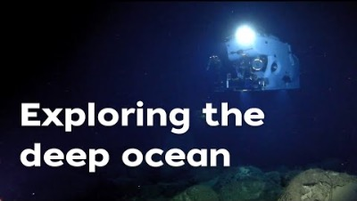
Alvin is an HOV (Human Operated Vehicle)

Slide 2
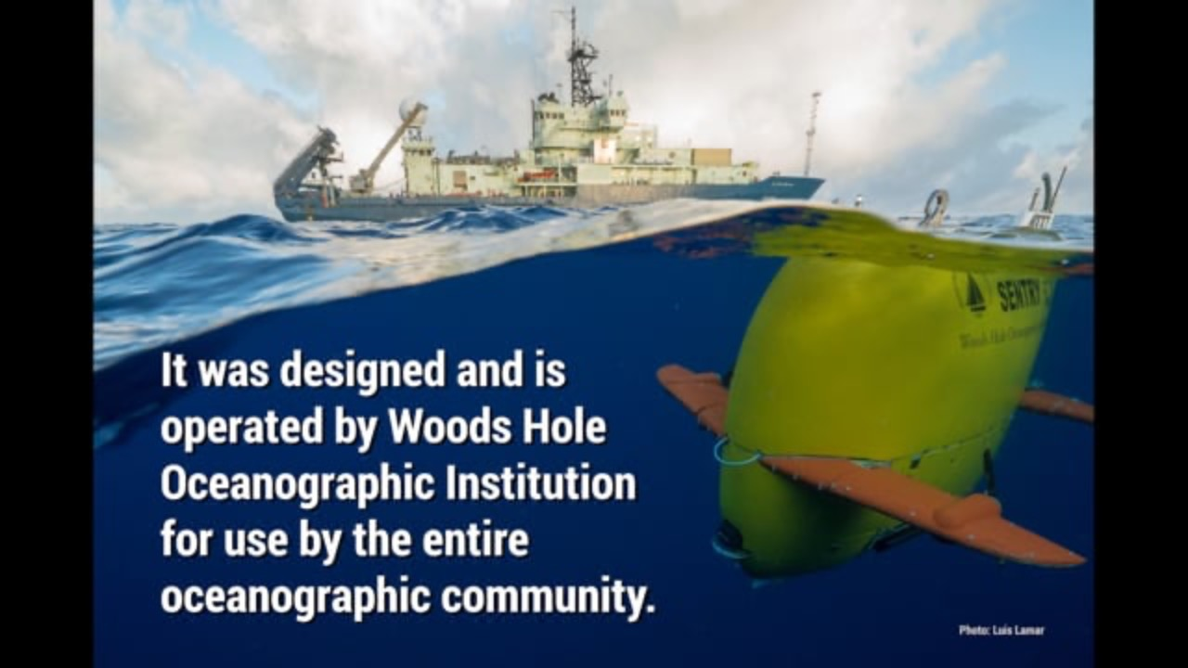
Jason is an ROV (Remotely Operated Vehicle), while Sentry is an AUV (Autonomous Underwater Vehicle)

Slide 3
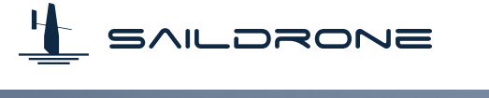
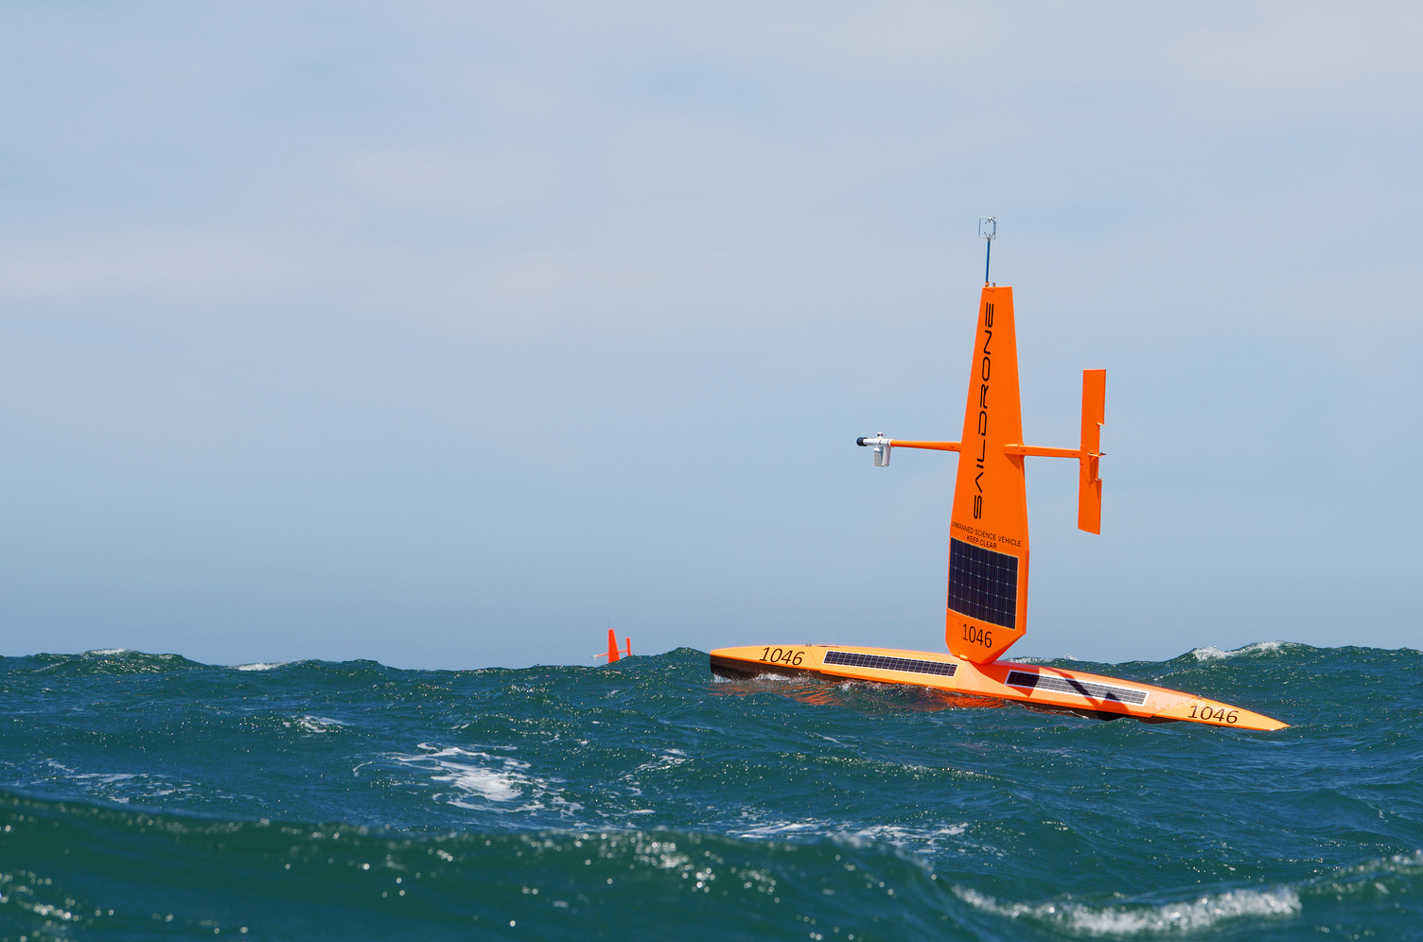
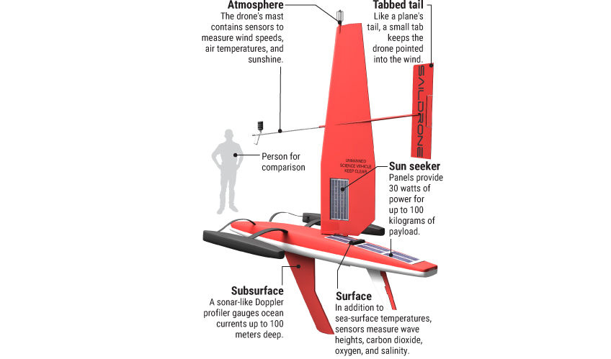
Uncrewed Surface Vehicle (USV)
7 meters+
Sail and solar powered, able to operate autonomously for up to one year

Slide 4
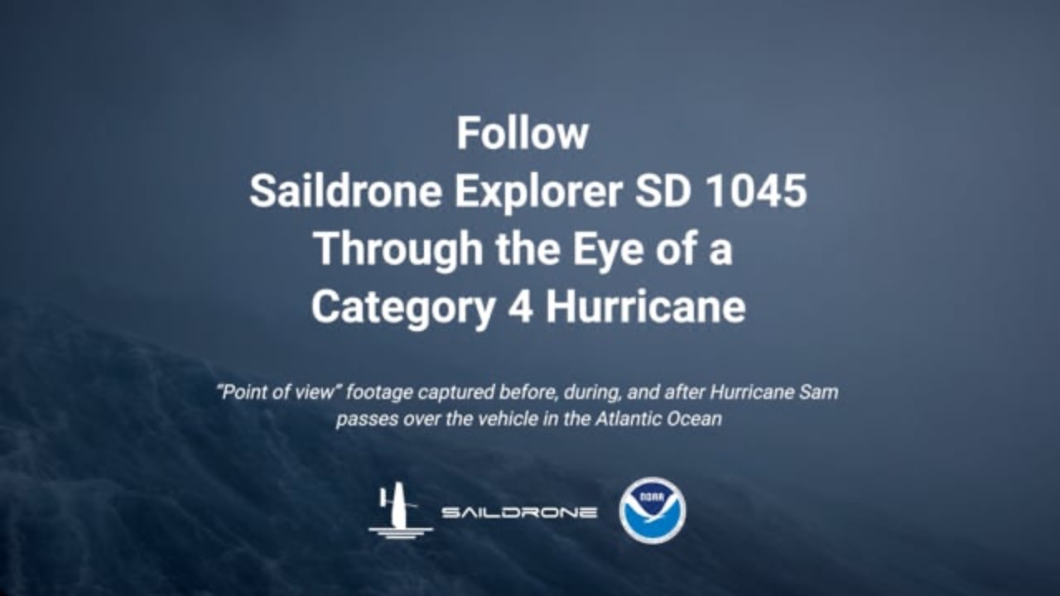

Slide 5
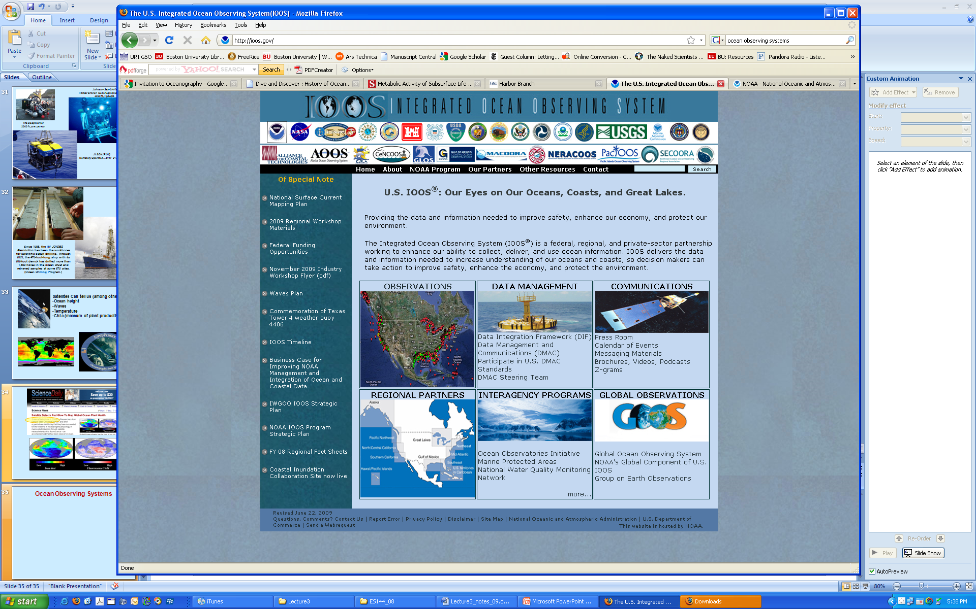
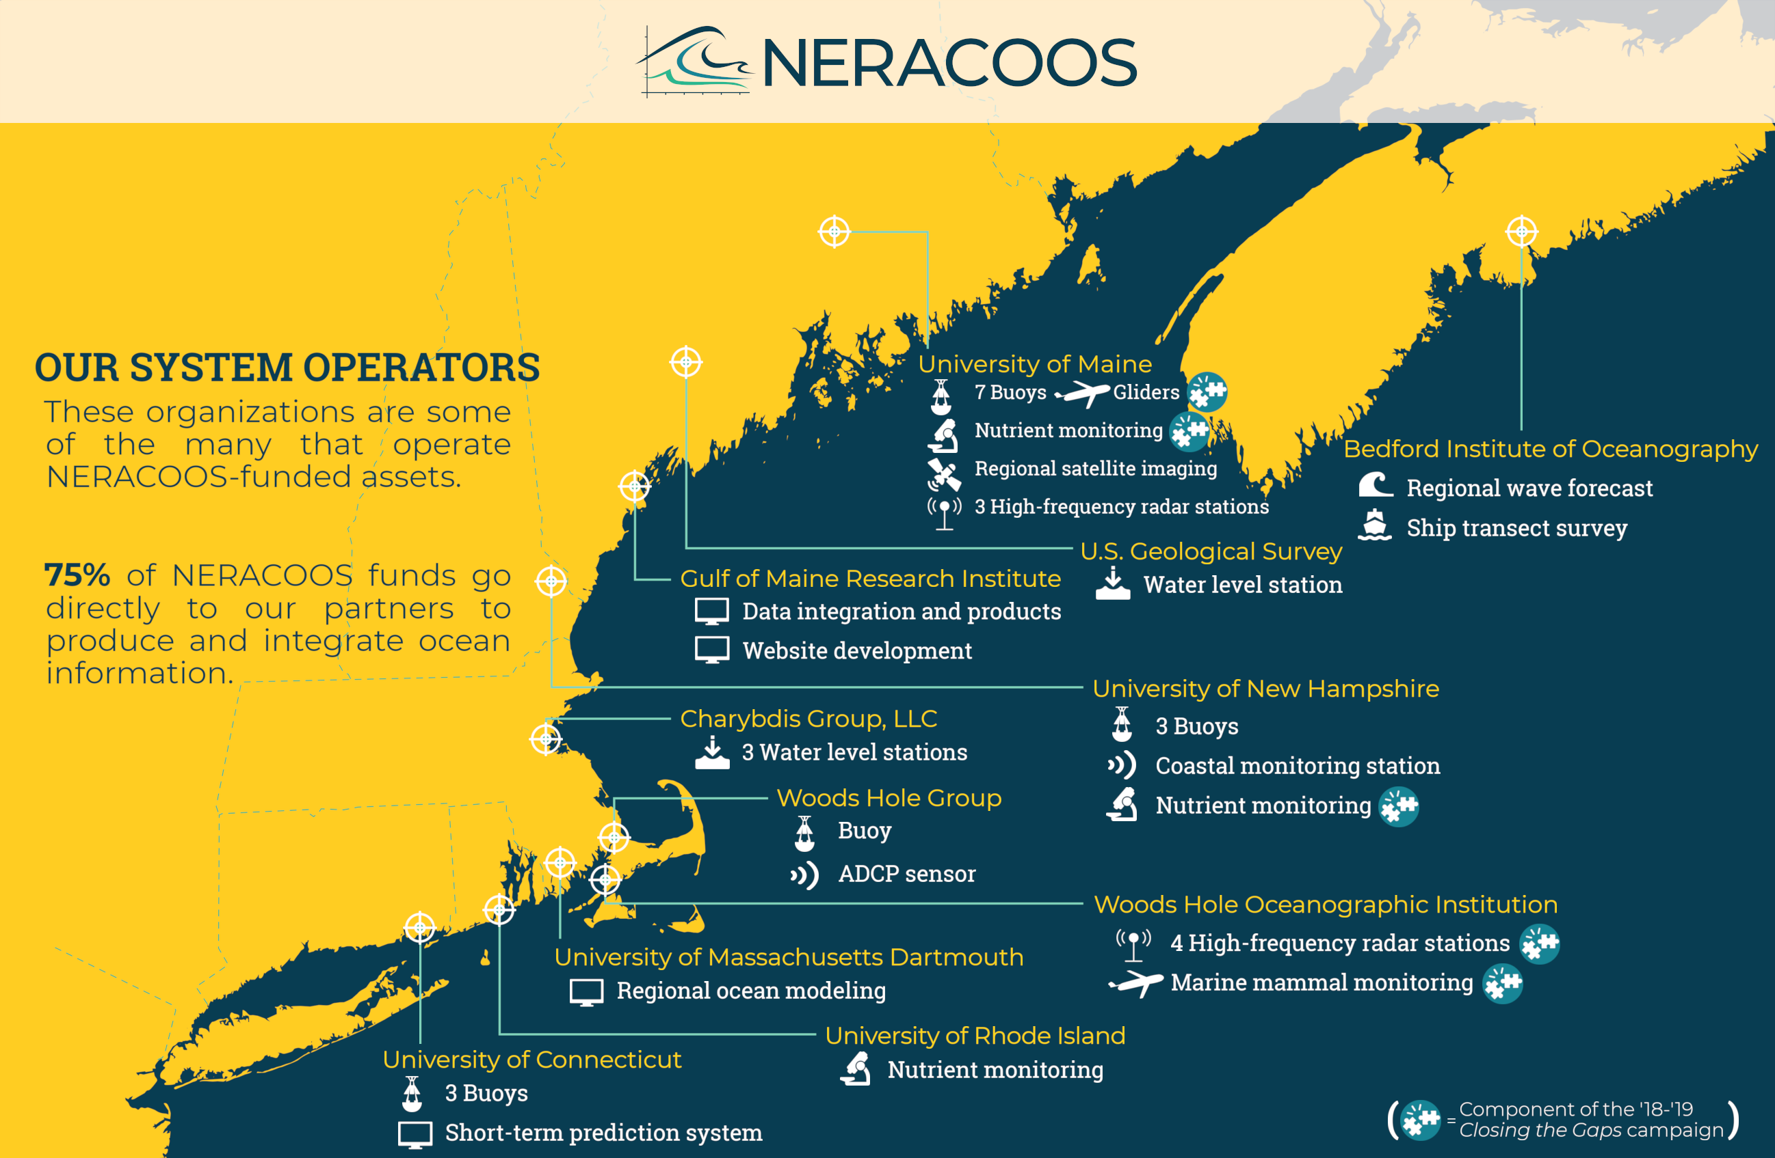
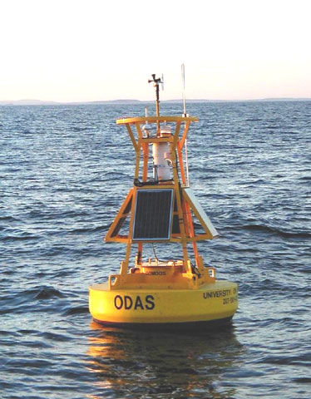
Ocean Observing Systems
IOOS is a NOAA funded network of regional observing systems – NERACOOS covers New England
A01 Buoy, Mass Bay

Slide 6
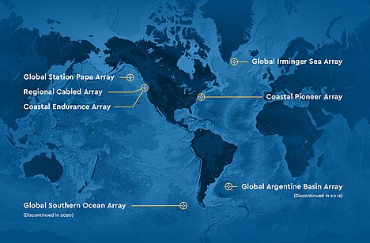
Ocean Observing Systems
Ocean Observatories Initiative (OOI) is a National Science Foundation funded network of specialized oceanographic sensor arrays, based out of Woods Hole. The Coastal Pioneer Array is off of Cape Cod

Slide 7
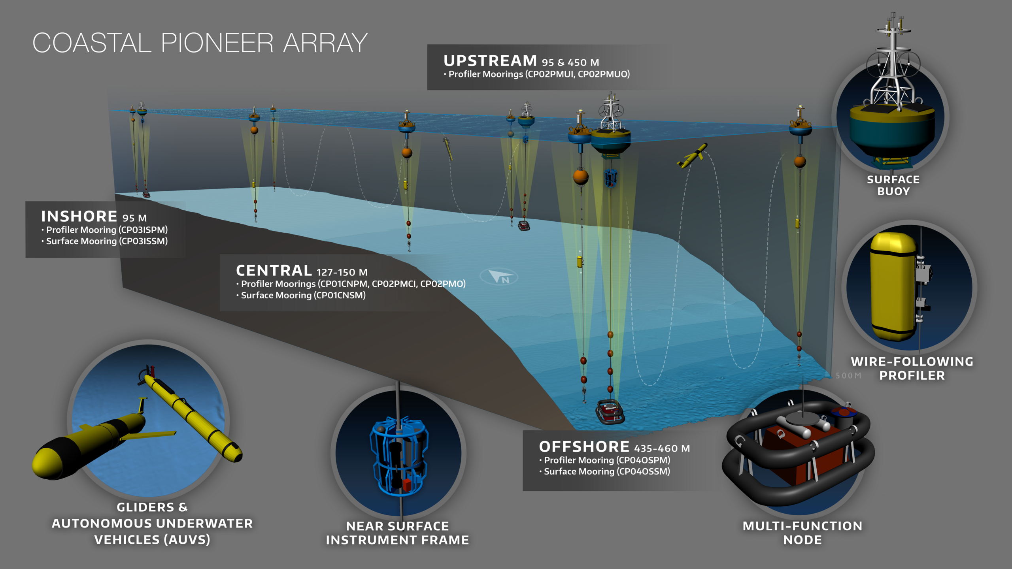
Climate variability, ocean circulation, ecosystems

Slide 8
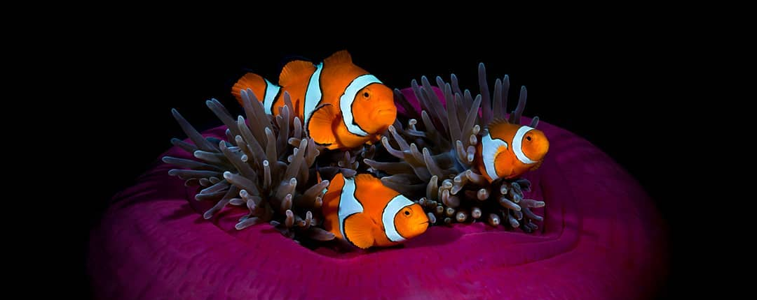
Buston Lab — Research Opportunities
The Buston Lab seeks two sophomores for fall semester of 2024 and beyond. In the first year, the position will involve learning to maintain large saltwater aquarium systems and care for clown anemonefish. Looking beyond the first year, there may be an opportunity to participate in research in the lab and qualified students may go on to develop an honors thesis. Biology and Marine Science majors, interested in animal behavior and marine biology, are encouraged to apply. Please send a short statement (250 words max) explaining why you are interested in working in the lab, along with a CV and screenshot of your transcript to Dr. Buston (buston@bu.edu).

Slide 9
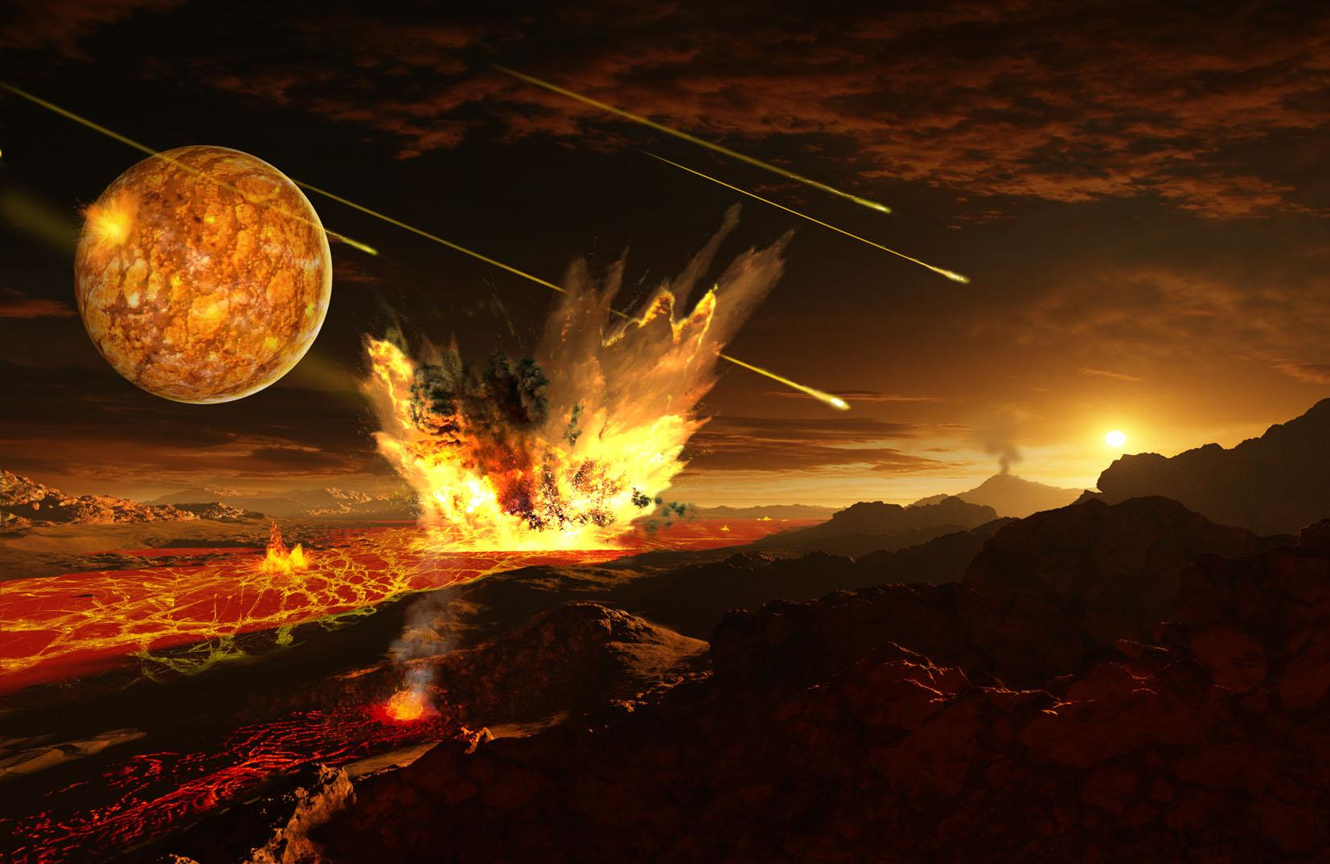
The Origin of the Earth and its Ocean
You should be reading Chapter 3 and 4 of the Webb textbook

Slide 10
“Nucleosynthetic” origin of the elements
The Sun, Earth, other planets, asteroids all contain at least a little bit of all these elements

Slide 11
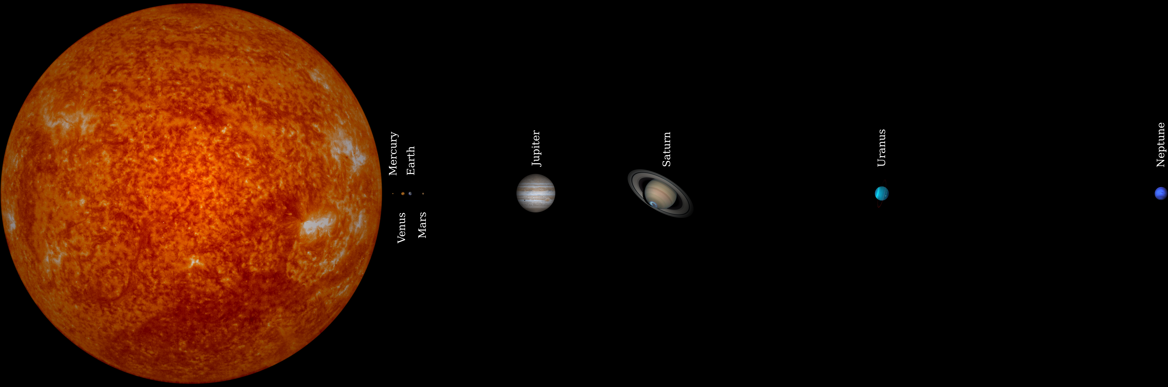
Solar System to Scale (relative sizes, not distances)
How do we get from raw elements to a solar system with the Earth and its Moon?
9 8 planets, 63 moons, asteroid belt, some comets, 5+ dwarf planets, and a star
“Frost Line”
Asteroid Belt (99.8% of meteorites come from here)
Comets→
99.9% of mass of solar system in sun

Slide 12
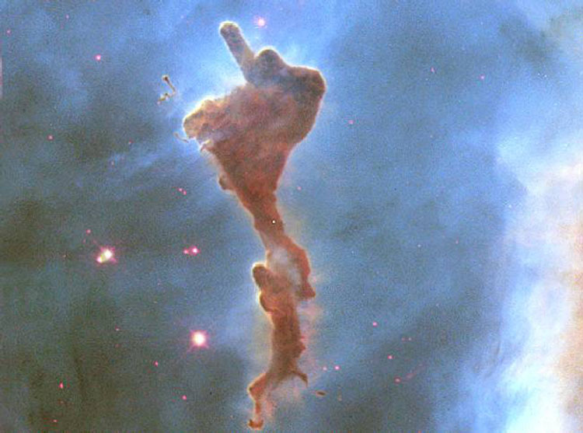
Hubble Space Telescope
image of a “molecular cloud”
(stellar nursery) in
Carina Nebula
Molecular clouds are mostly hydrogen, and temps are few 10’s of K
←2 light years →

Slide 13
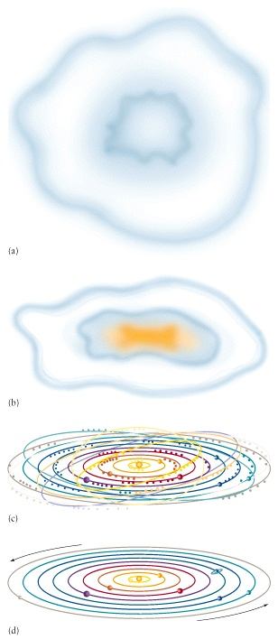
Solar Nebula Hypothesis
“Molecular Cloud”
(type of nebula)
Made of:
98% H, He, Li
from Big Bang nucleosynthesis
2% Heavier elements from stellar
nucleosynthesis in earlier generations
of stars (including supernovae)

Slide 14
Nebula contracts, spins, flattens and forms a “T-tauri” star at center
(“protoplanetary disk”)
Heat from collisions raises temp in disk >3000 K

Slide 15
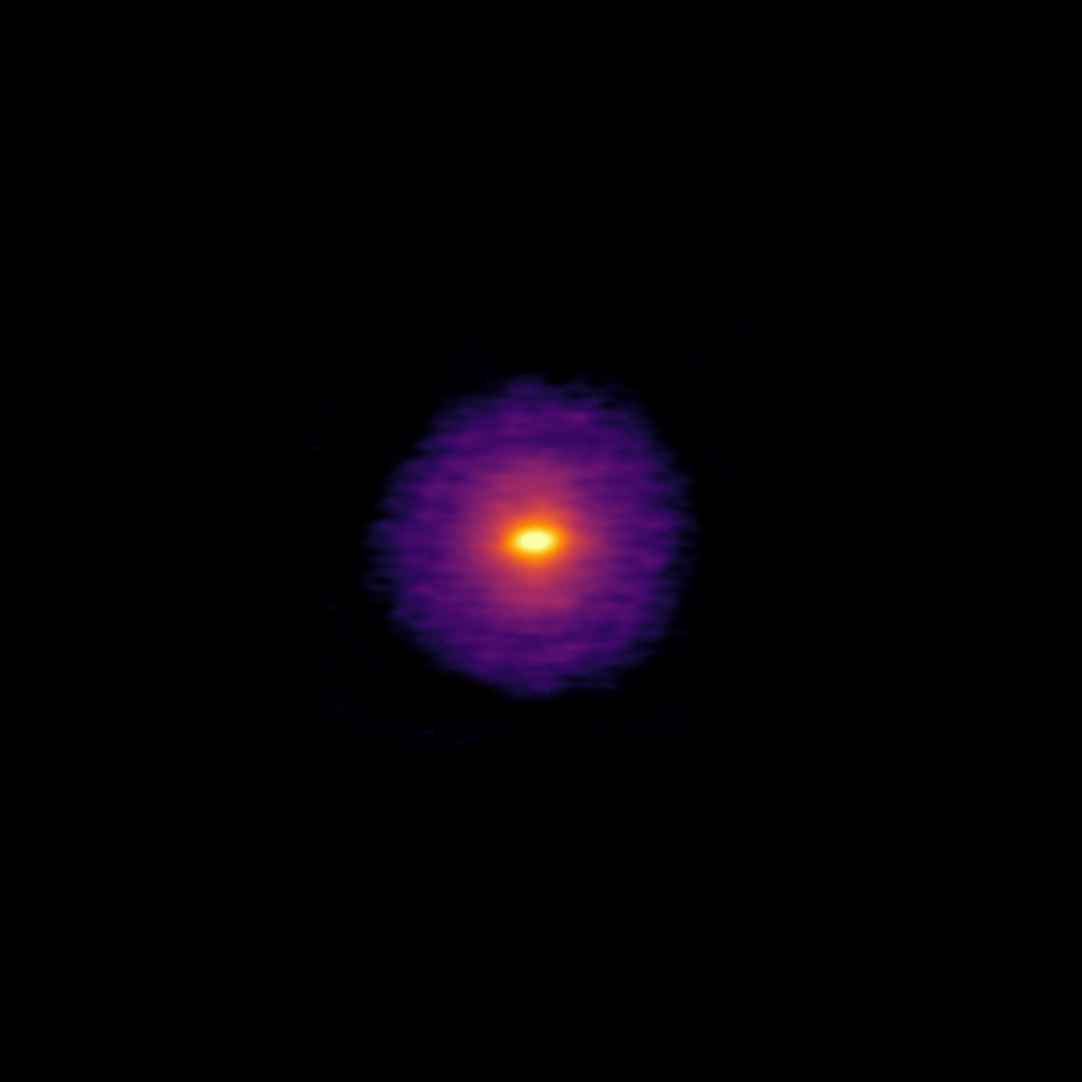
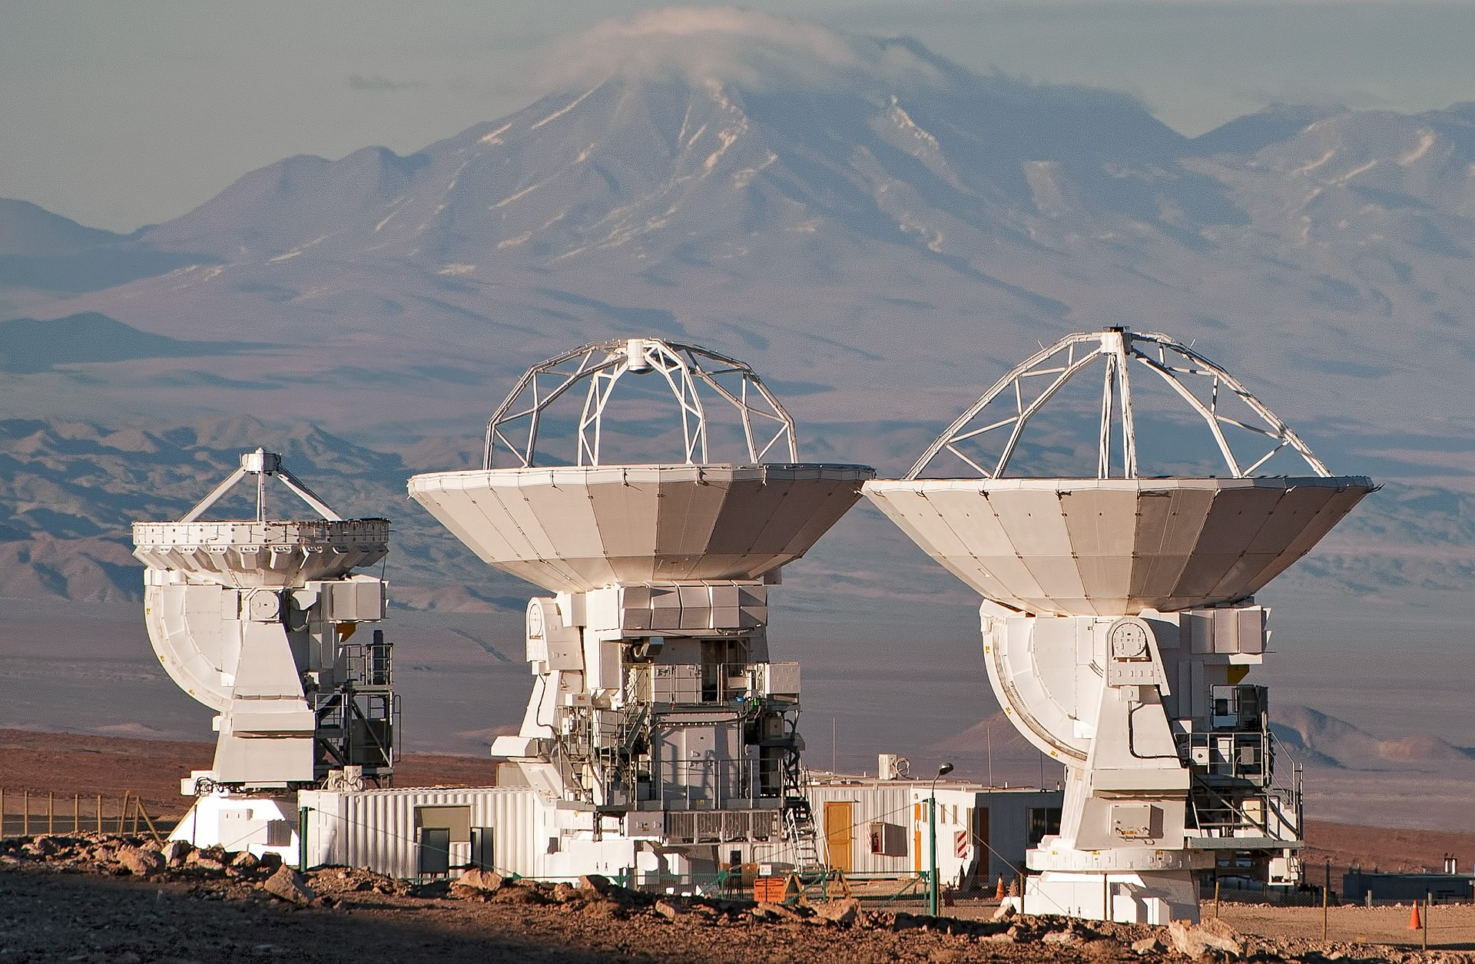
Observational Evidence From Astronomy: Protoplanetary Disks
Collection of protoplanetary disks from ALMA data
These are planet nurseries
HL Tauri imaged by the Atacama Large Millimeter Array (ALMA)

Slide 16
Once graviational collapse is done, solar system begins to cool (although star stays hot)

Slide 17
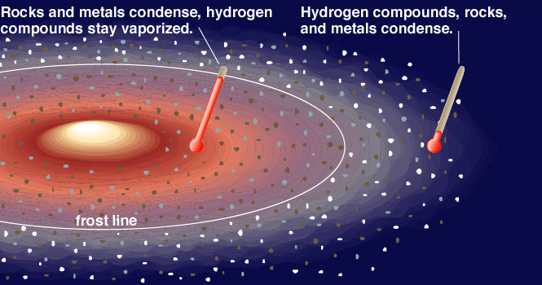
Condensation of the Solar Nebula
Earth is inside the “frost line” so should have been really water-poor

Slide 18
Once graviational collapse is done, solar system begins to cool (although star stays hot)
Debris in rings accrete to form Planetesimals (swept up like dust bunnies)

Slide 19
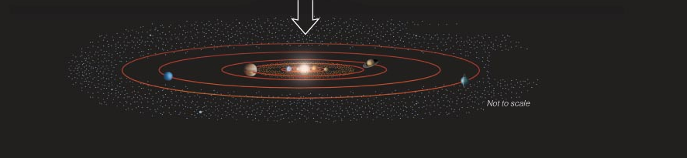
Sun’s fusion ignites (H fuses to form He and release energy)
Solar wind blows all the gas & dust away.
Leftover rocky planetesimals inside the frost line are asteroids.
Leftover icy planetesimals outside the frost line are comets.

Slide 20
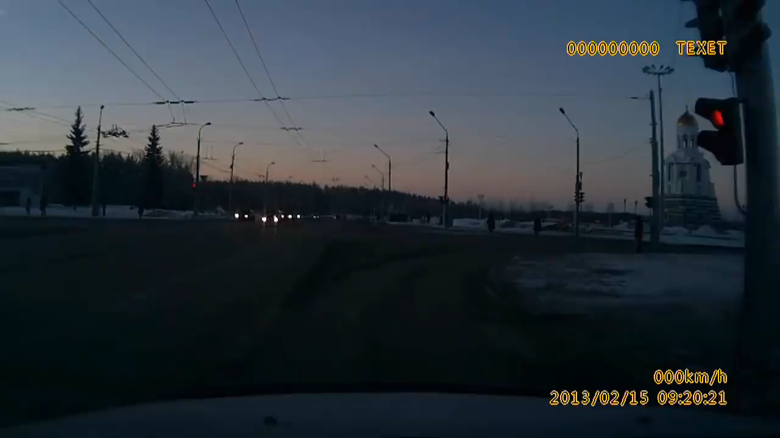
Chelyabinsk, Russia: February 2013
~20m diameter meteor, exploded at 30km altitude
Notes:
Wikipedia: The Chelyabinsk meteor was a superbolide caused by a near-Earth asteroid that entered Earth's atmosphere over Russia on 15 February 2013 at about 09:20 YEKT (03:20 UTC), with a speed of 19.16 +/- 0.15 kilometres per second (60,000[5] - 69,000 km/h or 40,000[5] - 42,900 mph).[6][7] It quickly became a brilliant superbolide meteor over the southern Ural region. The light from the meteor was brighter than the Sun, even at 100 km distance. It was observed over a wide area of the region and in neighbouring republics. Eyewitnesses also felt intense heat from the fireball.
On account of its high velocity and shallow angle of atmospheric entry, the object exploded in an air burst over Chelyabinsk Oblast, at a height of around 29.7 km (18.4 miles, 97,400 feet).[7][8] The explosion generated a bright flash, producing a hot cloud of dust and gas that penetrated to 26.2 km, and many surviving small fragmentary meteorites, as well as a large shock wave. The majority of the object's energy was absorbed by the atmosphere, with a total kinetic energy before atmospheric impact equivalent to approximately 500 kilotons of TNT (about 1.8 PJ), 20–30 times more energy than was released from the atomic bomb detonated at Hiroshima.

Slide 21
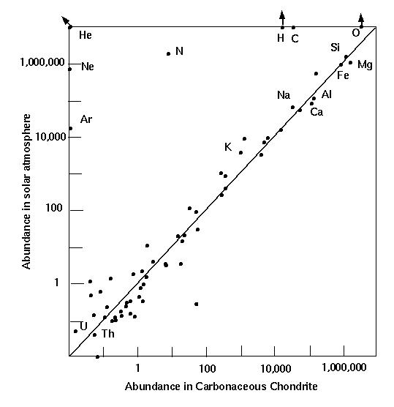
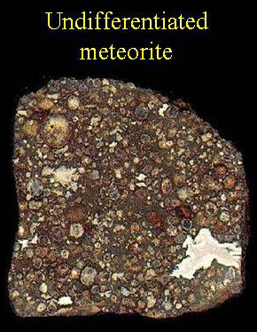
Chondrites
Chemistry same as Sun (- volatiles)
ottawa.rasc.ca/
www.umich.edu/~geo113/113/3/solar_abund.jpg
Some of these chondritic meteorites are loaded with organic molecules, amino acids (abiotic synthesis)

Slide 22
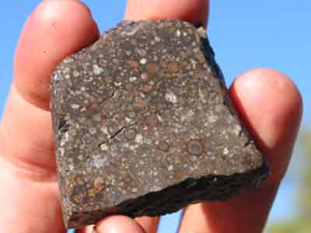
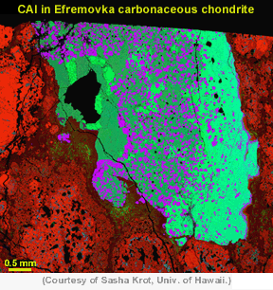
NWA 2364 is a carbonaceous chondrite meteorite found in northwest Africa in 2004
Age of 4.568 billion years measured on a CAI grain (“calcium-aluminum rich inclusion”).
http://www.lpi.usra.edu/meteor/metbull.php?code=30982
CAI’s interpreted to be the first solids that condensed out of the protoplanetary disk
http://www.psrd.hawaii.edu/Mar00/supernovaDebris.html
Notes:
Mineralogical map of a calcium-aluminum-rich inclusion (CAI) in the Efremovka carbonaceous chondrite. In this image, obtained with an electron microprobe, the square and diamond-shaped, purplish grains are spinel, an aluminum-rich mineral. The light-green and green areas are crystals of minerals rich in both calcium and aluminum. Red area is the surrounding rock, which consists mostly of minerals rich in magnesium and iron. CAIs are thought to be among the very first solids to form in the solar nebula. Most have clear evidence for the presence of aluminum-26, but some have almost none. The variation means either that some formed millions of years after the others, or that aluminum-26 was not distributed uniformly in the solar nebula.

Slide 23
“Terrestrial Planets”
(Mercury, Venus, Earth, Mars)
accrete from metals, silicates
“Gas Giants”
(Jupiter, Saturn, Uranus, Neptune)
accrete from volatile ices + H, He
Planetesimals within rings eventually swept together to form Planets

